Slide 1


Spotify Network Analysis
Salem Arthur, Marianna Carini, Eric Chen, Edward Shih-Yu Chung, Haiying Ge

Slide 2
Agenda.
Problem Statement
Exploratory Data Analysis
Clustering
Network Analysis
Prediction
Conclusion

Slide 3


All the music you’ll ever need.
Daniel Ek
Martin Lorentzon
2008
Sweden
$8B
155M
Launch
Head Quarters
Revenue
Paid Subscribers
Notes:
Since launching in 2008, Spotify has grown to become a global leader in the digital music, podcast and video streaming space by providing access to millions of content to users across the globe. The Swedish company with it’s “Freemium” pricing model and strategy has been able to gain considerable market share from its competitors like Apple Music, Tidal, Deezer and Amazon Music. This was further bolstered by a strong 2020 Q4 report; outlining a whopping 155 million paid subscribers while growing its total user base by 27%.
ek: https://www.google.com/url?sa=i&url=https%3A%2F%2Ftwitter.com%2Feldsjal&psig=AOvVaw3KYucYJb0yGYZ62K8qcT6r&ust=1615486794810000&source=images&cd=vfe&ved=0CAIQjRxqFwoTCKDbprurpu8CFQAAAAAdAAAAABAD
https://www.statista.com/statistics/813713/spotify-revenue/#:~:text=In%20the%20last%20presented%20year,six%20billion%20euros%20that%20year.

Slide 4
Introduction.
Steaming makes up 83% of the music industry as of 2020. The availability of extensive music characteristics available from Spotify led us to the idea of exploring the importance of all these different variables in the relative popularity of a given song. This would lead to business implications for the $12.2B sub-industry.
Notes:
https://www.engadget.com/riaa-music-revenue-report-2020-204907874.html#:~:text=Streaming%20music%20made%20up%2083%20percent%20of%20the%20record%20industry's%20revenue%20in%202020

Slide 5
Problem statement.
Can we identify themes between the most popular songs?
Can we accurately predict which songs will be popular based on the various audio features and network structure?
With these insights, can we identify which features are most important for a song to be successful in the US market?

Slide 6
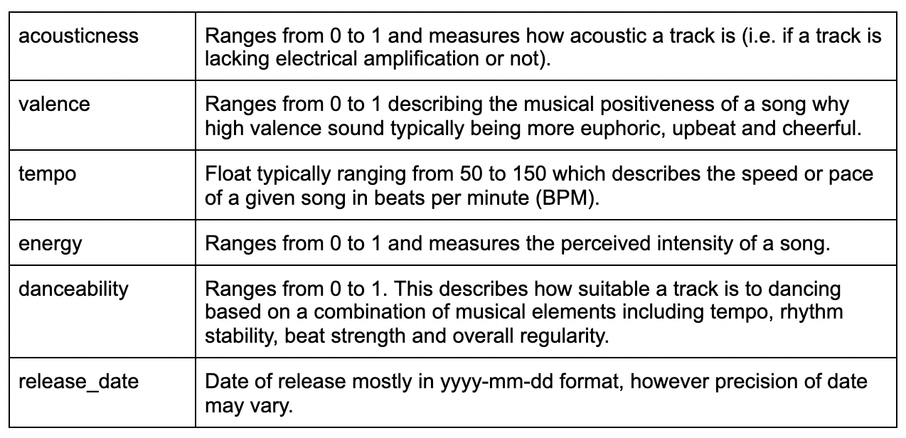
Data description.
Contains data for over 175,000 songs collected from the Spotify Web API
Has a primary ID variable and contains numerical, categorical and dummy variables
We also had supplemental datasets grouped by artists, genres and years

Slide 7
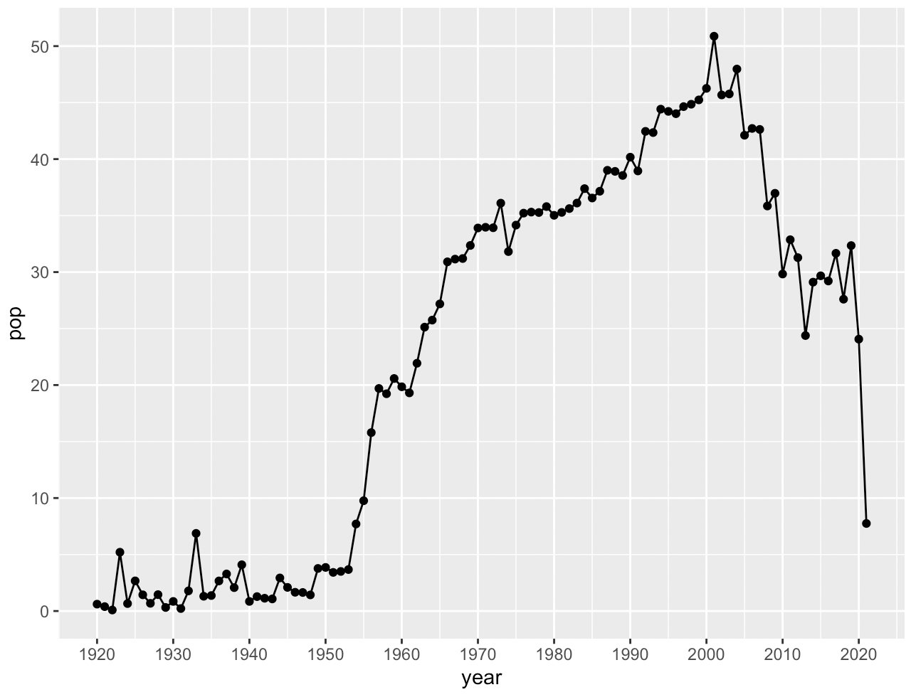
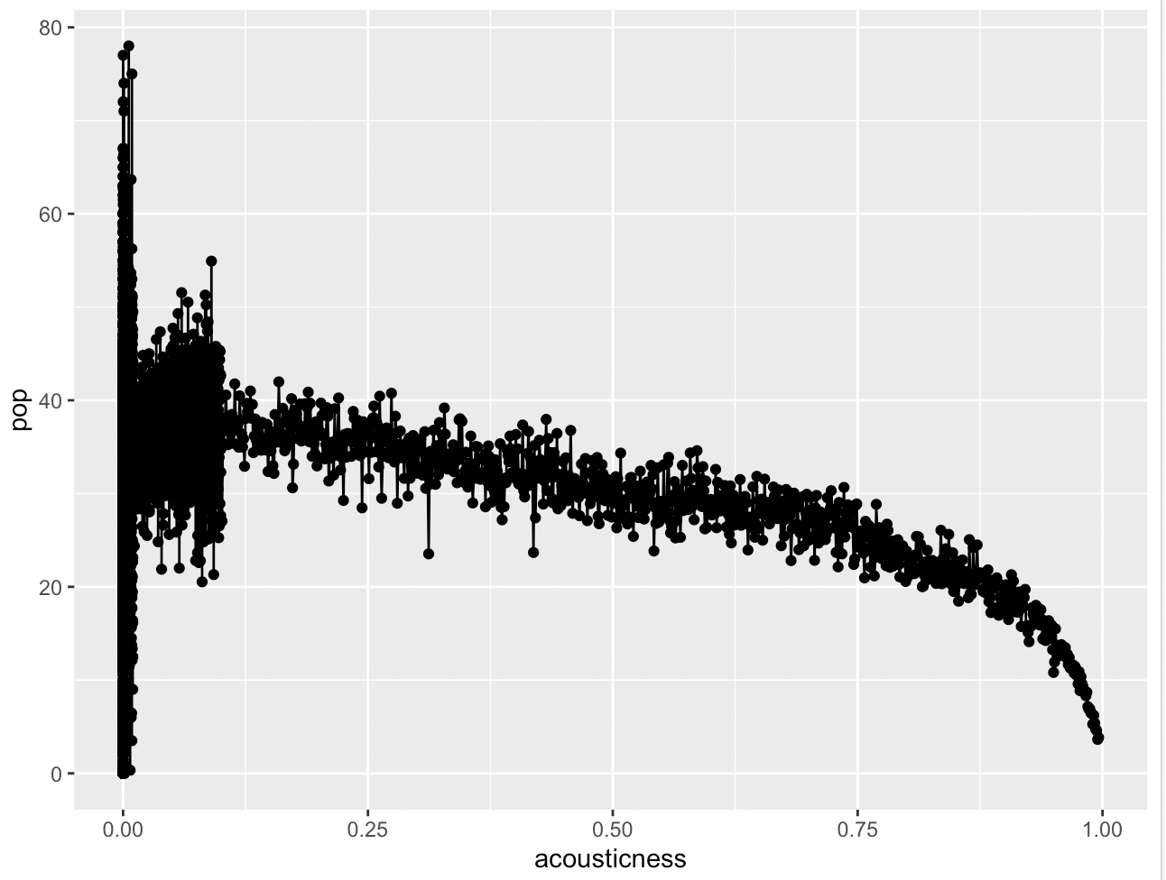
Exploratory data analysis.
Mean Popularity of Songs by Year
Popularity vs. Acousticness
Notes:
Pop by year: In US, most popular music tends to be music from 1960 to 2010
Pop vs. Acoustics: the higher the acoustic rating (less electric), the less popular the song on average

Slide 8
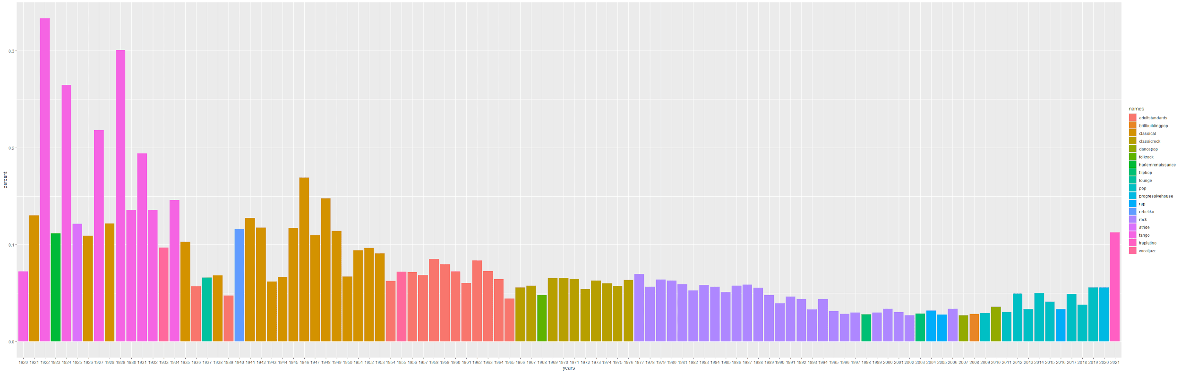
Exploratory data analysis.
Top Genres each year with the percentage of it
Notes:
Most popular genre clustered in eras
In 20’s and 30’s, most popular genres were more dominant than recent history. Potentially have more diversity in music today due to internet?

Slide 9
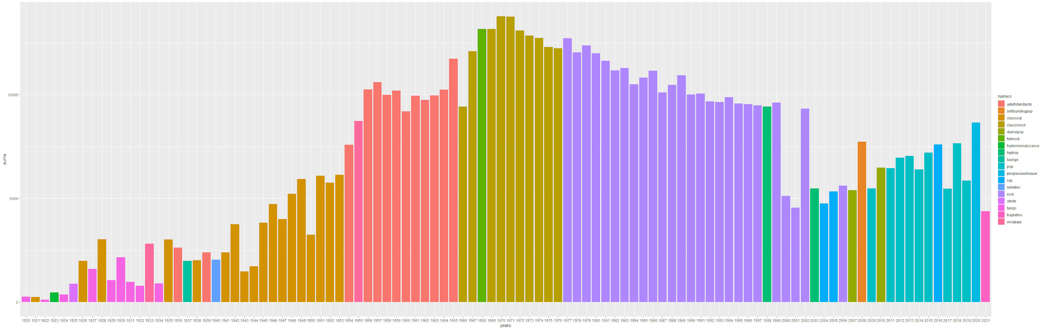
Exploratory data analysis.
Top Genres each year with total number of genres of the year
Notes:
More music published in 60’s to 70’s.
Potential explanation: music was a main source of entertainment. Today we have more options.

Slide 10
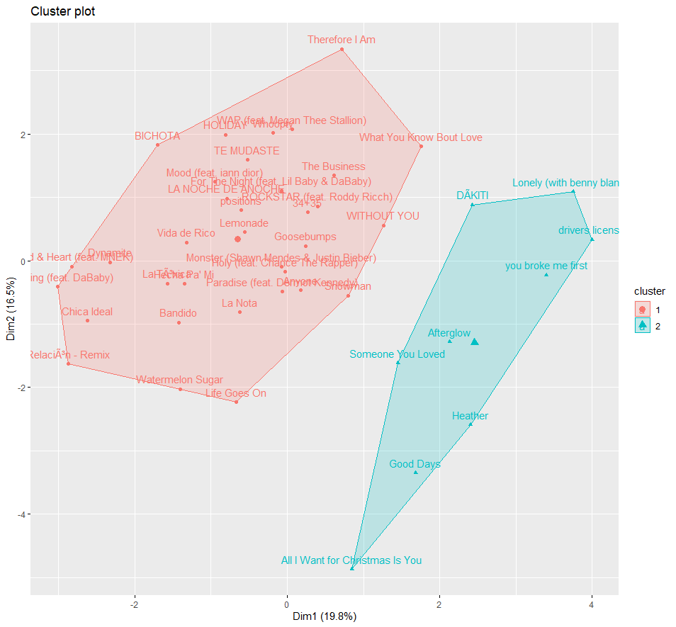
Clustering most popular songs.
Popularity score 90+
Used clustering to identify themes in most popular songs
Two distinct clusters

Slide 11
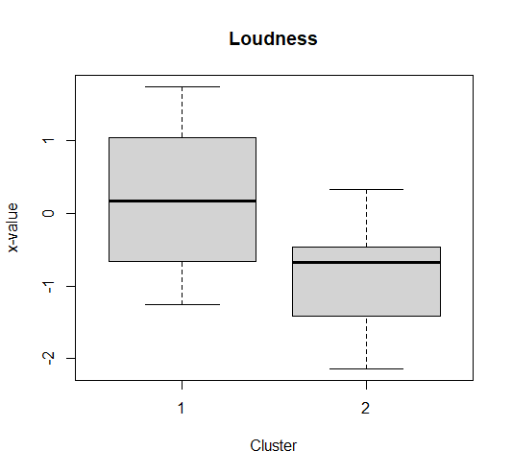
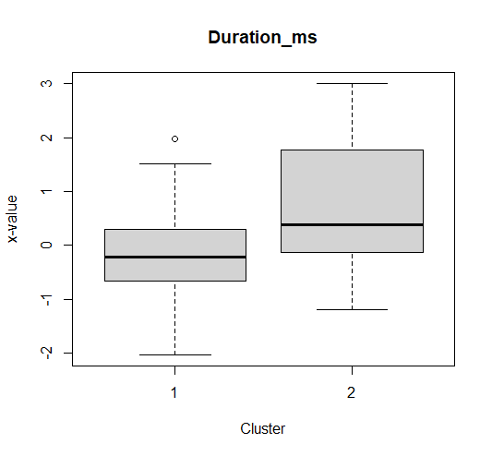
Clustering most popular songs.

Slide 12
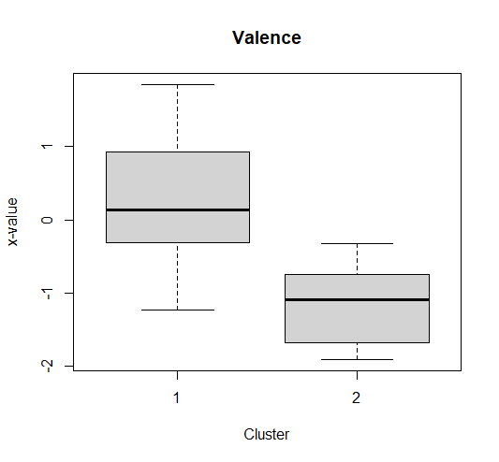
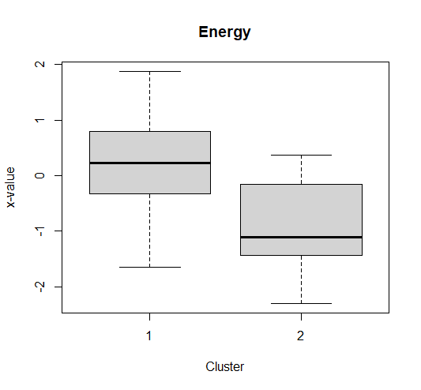
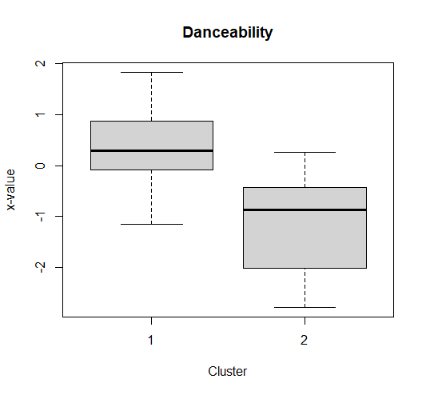
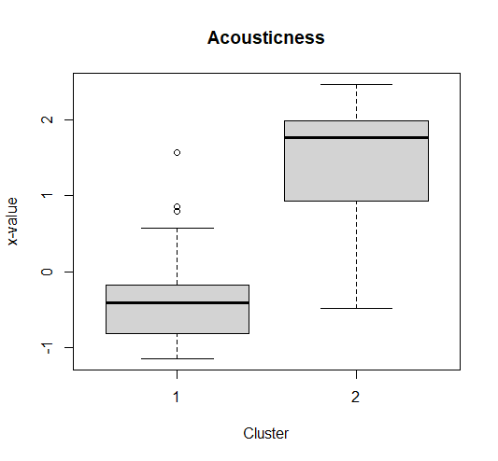
Clustering most popular songs.
Notes:
Valence - describes the musical positiveness conveyed by a track
Acousticness - an attribute that is calculated by Spotify and is a confidence measure from 0.0 to 1.0 representing if the track is acoustic.1.0 represents high confidence the track is acoustic

Slide 13
Network analysis.
All artists
Popular artists
Artists with 1+ “popular” songs (rating of 70+)
Avg. degree: 11.28
Avg. authority score: 0.00019
Avg. closeness: 6.12e-09
Avg. betweenness: 19391.23
Mean distance: 7.57
Density: 0.0006
Avg. degree: 6.85
Avg. authority score: 0.00075
Avg. closeness: 4.02e-07
Avg. betweenness: 4782.94
Mean distance: 5.59
Density: 0.0021
Notes:
Define groups
Closeness, betweenness, dist

Slide 14
Network analysis.
Tested significance of difference in network metrics between popular artists and non-popular artists
Difference in means of authority scores not statistically significant
Difference in means of closeness and betweenness statistically significant
Closeness: Non-popular: 5.85e-09 vs. Popular: 4.02e-07
Betweenness: Non-popular: 9662 vs. Popular: 4783
Higher closeness in popular artist community: popular artists community is a “smaller circle” than non-popular artists
Lower betweenness in popular artist community: popular artists are less likely to bring different artists together
Notes:
Difference between popular and non-popular artists
t-test in appendix
add means in slide

Slide 15
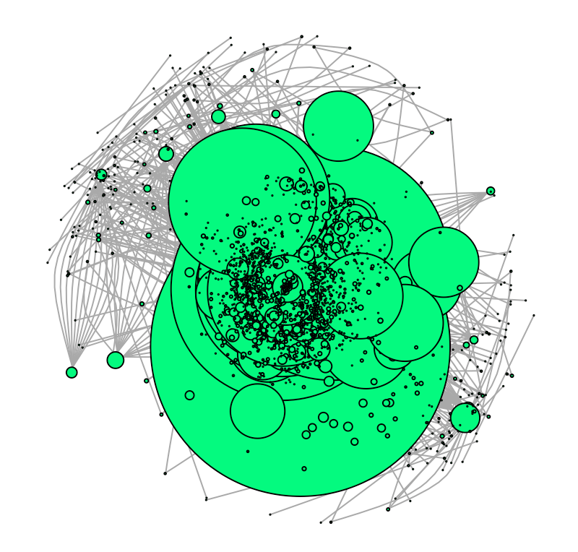
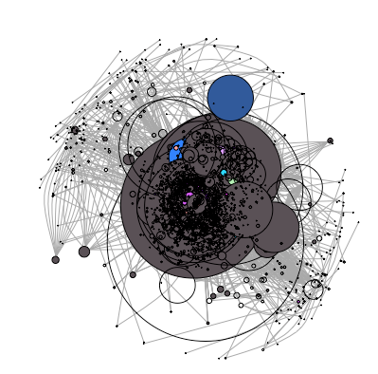
Network analysis.
Visual aligns with metrics results
Nodes congregate in center
High number of connections, lack of “islands”
Visual evidence of homophily

Slide 16
Network analysis.
Degree
Highest genre: Dancepop
Lowest genre: Tropicalhouse
Authority score
Highest genre: Dancepop
Lowest genre: Tropicalhouse
Closeness
Highest genre: Hip hop
Lowest genre: Acid house, acid rock, etc.
Betweenness
Highest genre: Hip hop
Lowest genre: Tropicalhouse, ukdance, etc.

Slide 17
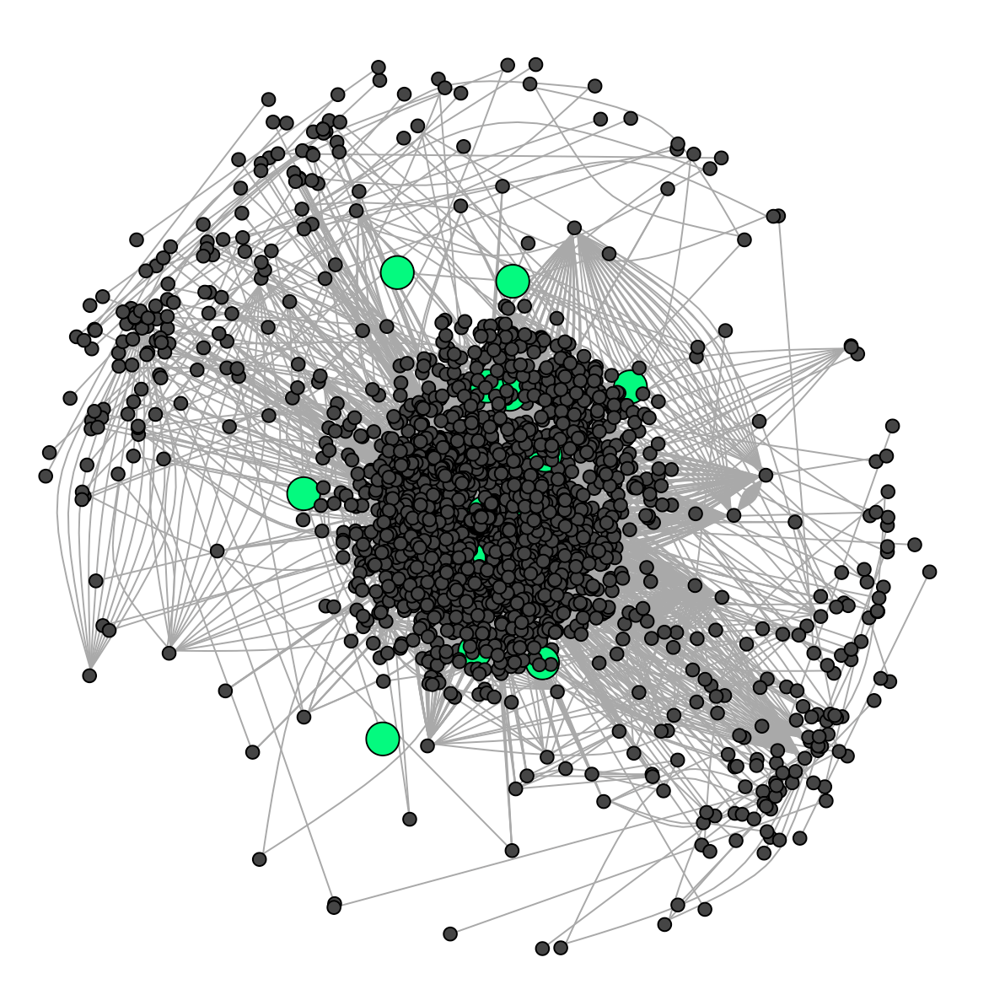
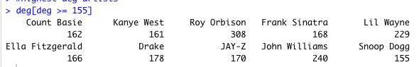
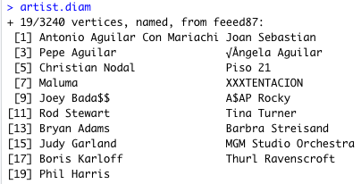
Network analysis.
Top artists by degree
Diameter length: 19
Most polarizing artists: Antonio Aguilar Con Mariachi (mariachi) and Phil Harris (big band)
Notes:
include full diameter

Slide 18
Prediction.
Goal: predict popularity of song based on song profile, network metrics (closeness, degree, etc.), neighbor profile
Final model included:
avg. neighbor danceability rating: -11.89
log of avg. neighbor duration: 1.72
avg. neighbor loudness rating: -0.22
avg. neighbor popularity: 1.00
danceability rating of song: 5.03
whether or not a song is explicit: 2.03
R-squared: 0.651

Slide 19
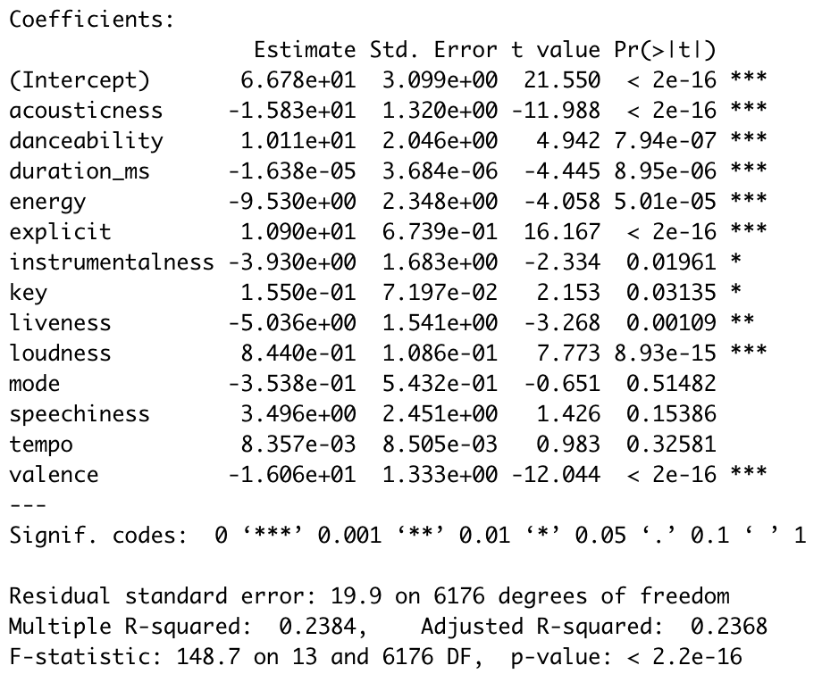
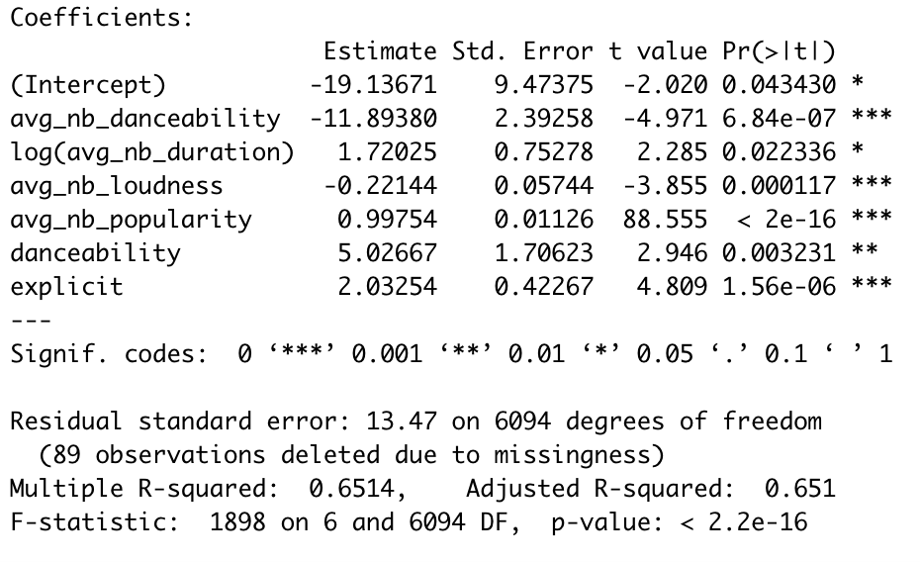
Network analysis.
Song profile model
Only using features of song in regression model
Network model
Model with neighbor values along with song features

Slide 20
Conclusion.
Clustering conclusion: two main types of popular songs; upbeat/party songs and slow-paced/serious songs with an emphasis on the upbeat songs
Network insights: popular artist community is a “small circle” compared to non-popular artists
Prediction implications: neighbor’s avg. song profile is important in popularity of song
To break into the popular community, artists should leverage their peers’ audience
Spotify could capitalize on this with their recommendation system
Dance remixes of songs are not generally preferred, update recommendation model accordingly

Slide 21
THANK YOU!

Slide 22
Exploratory Data Analysis
https://drive.google.com/file/d/1jHzip4FfyKmCXA90ThIW9ttXpc8as_vI/view?usp=sharing

Slide 23
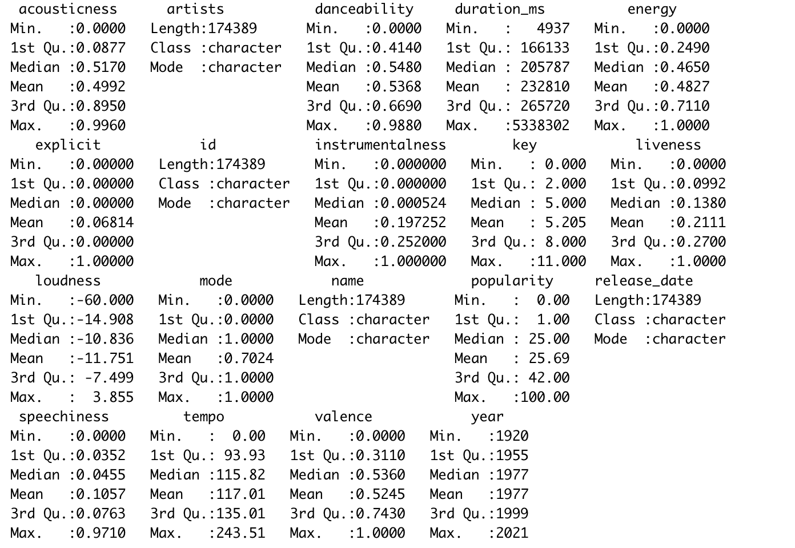
EDA

Slide 24
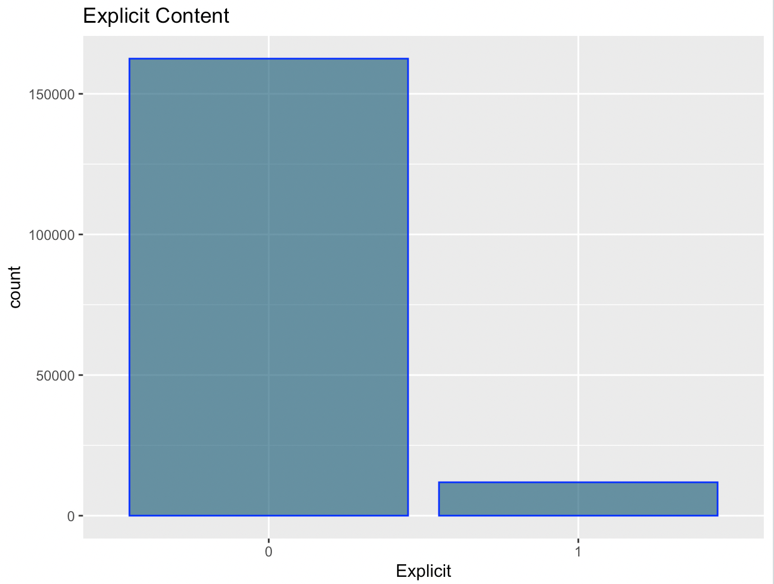
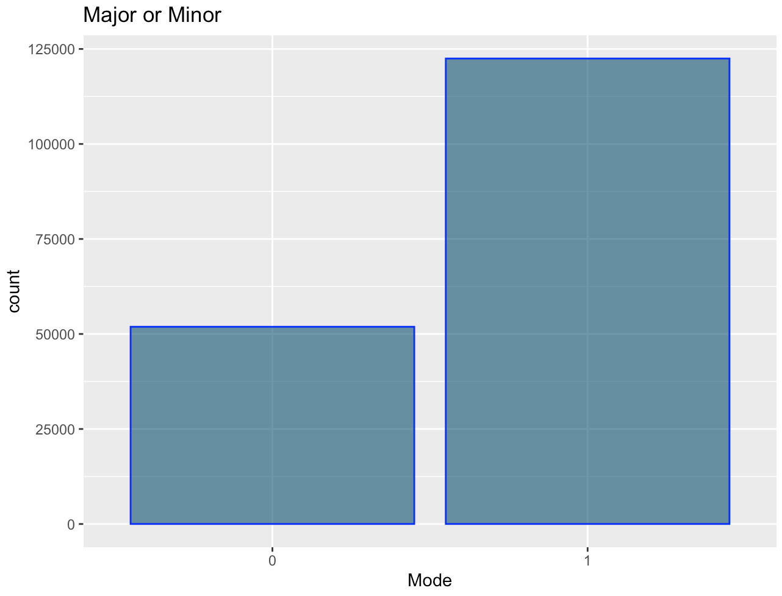
EDA
Our boxplots show us that we have an overwhelmingly large number of censored music compared to explicit music and that we have more than double the number of songs in a major chord than we do for those in a minor chord.

Slide 25
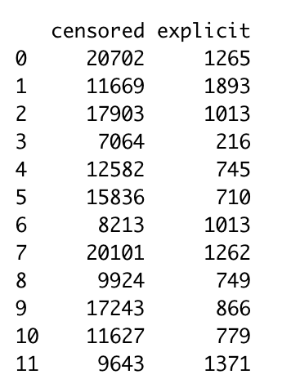
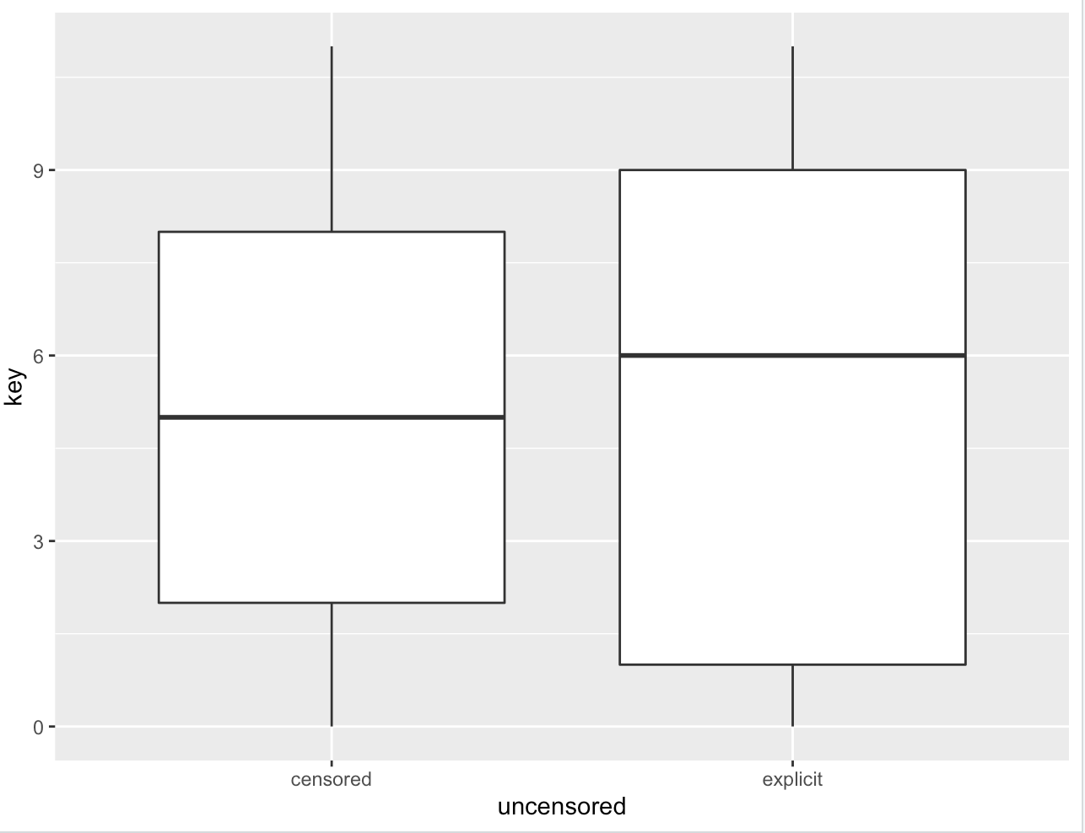
Exploratory Data Analysis

Slide 26
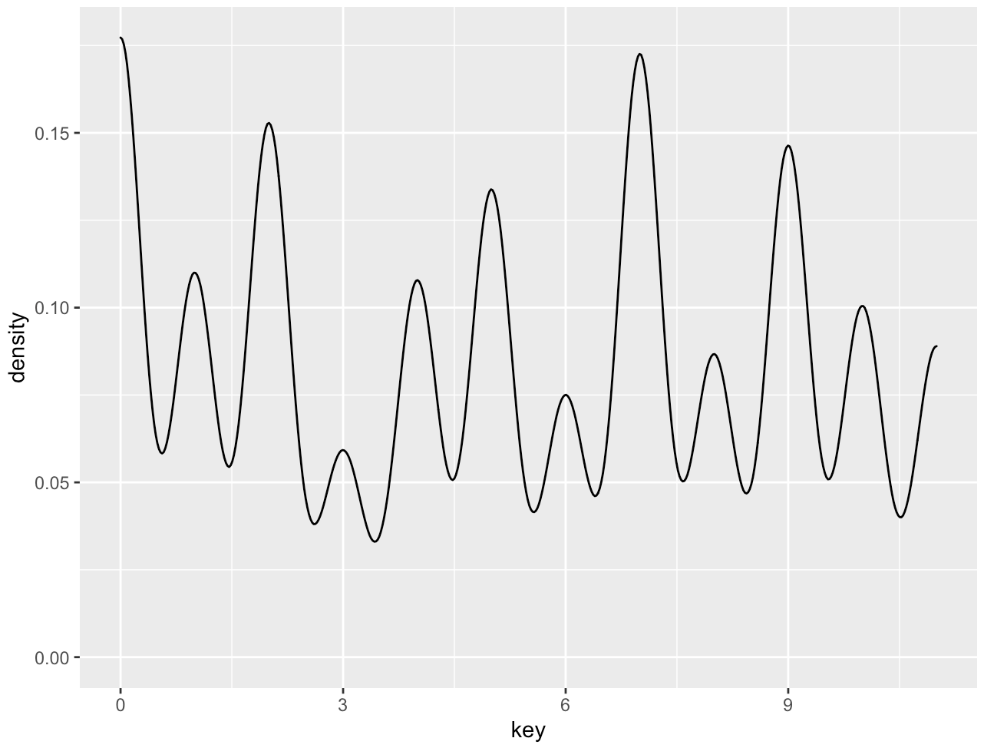
Exploratory Data Analysis

Slide 27
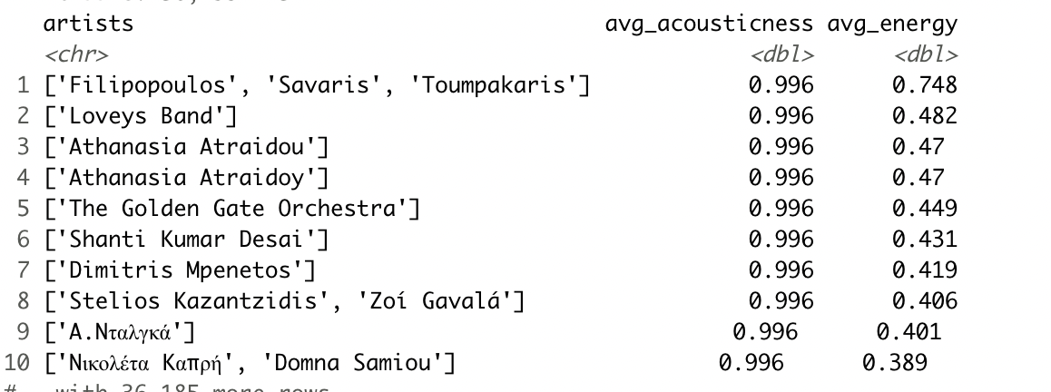
Exploratory Data Analysis

Slide 28
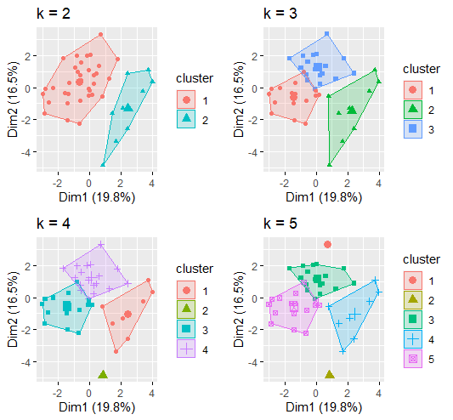
More Clusters

Slide 29
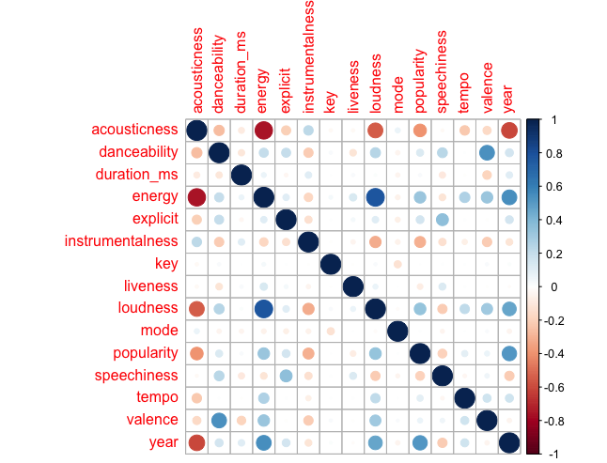
Exploratory Data Analysis

Slide 30
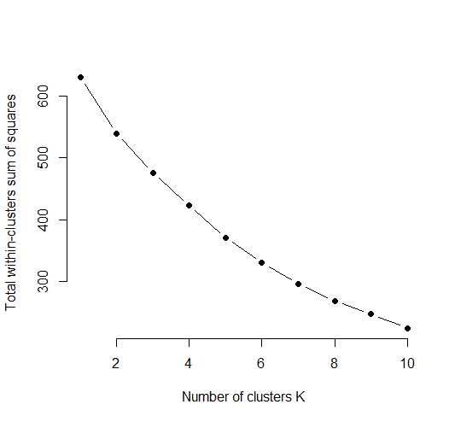
Elbow Chart

Slide 31
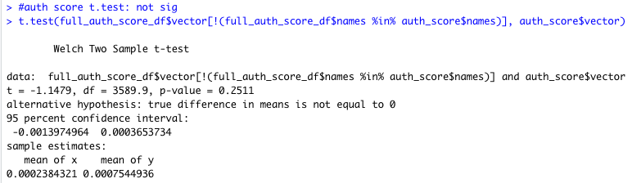
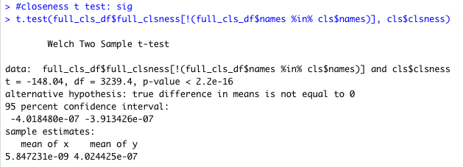
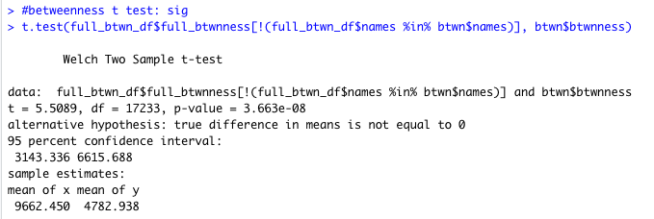
T-Tests

